Slide 1
Offline Quiz
Tableau Charts

Slide 2
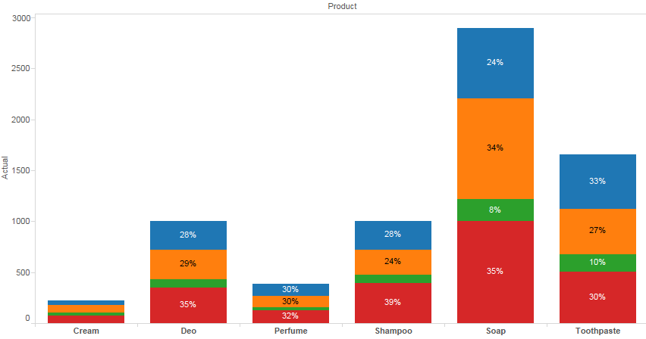

Use – “Sales_Target.csv” to create chart below.
Show largest selling products and also show what % of sales is coming from which regions.

Slide 3
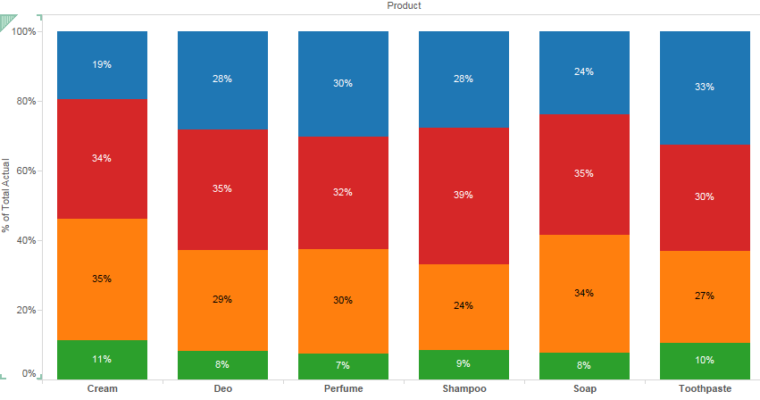
Convert the chart created in previous slide to 100% staked.

Slide 4
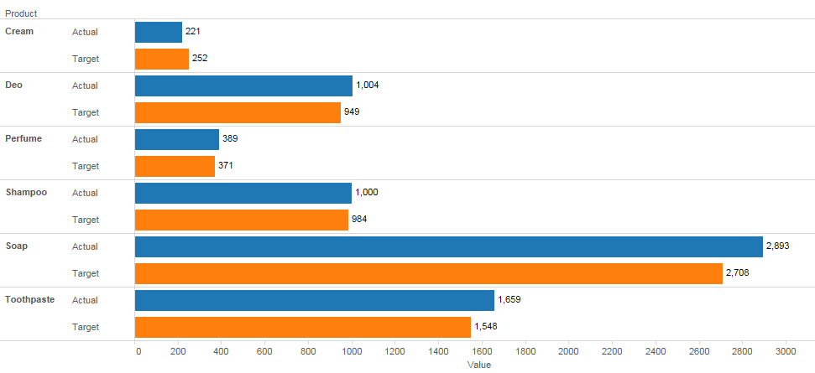
Create a side by side bar to compare Actual vs Target sales of different products.

Slide 5
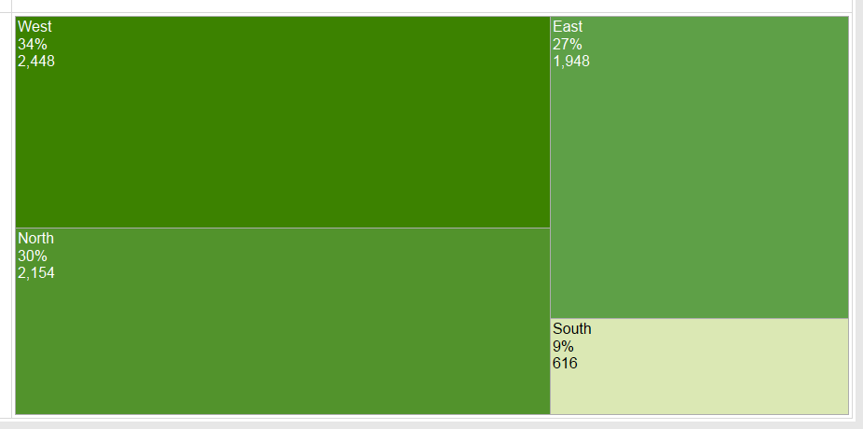
Create a tree map to show largest selling regions.

Slide 6
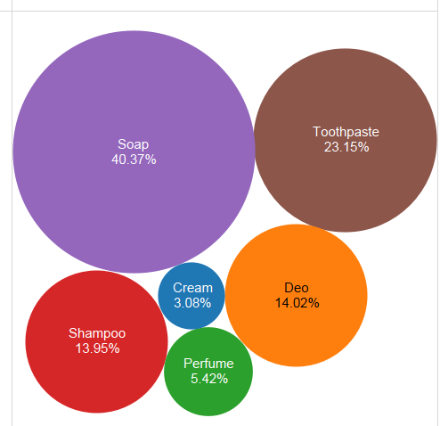
Create a packed bubble to show product sales.

Slide 7
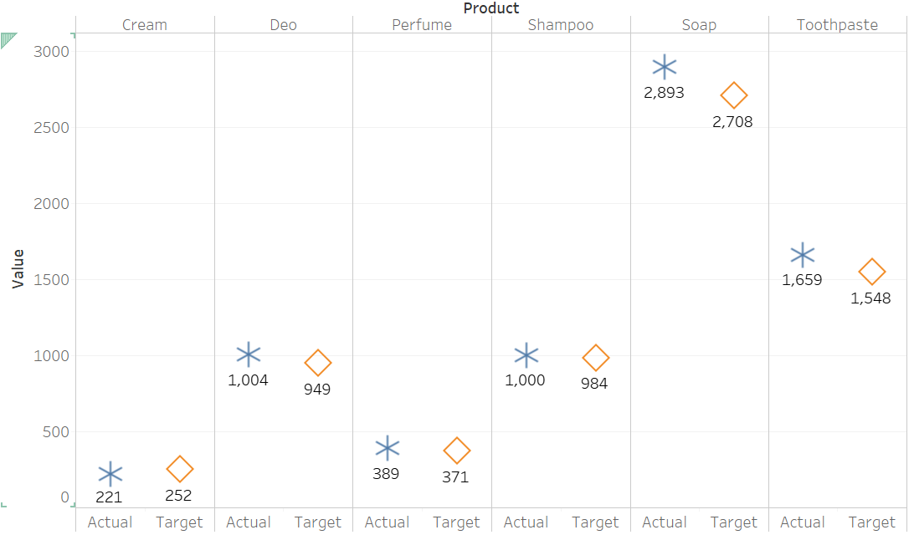
Create a side by side circle chart to compare actual vs target sales of different products.

